Slide 1
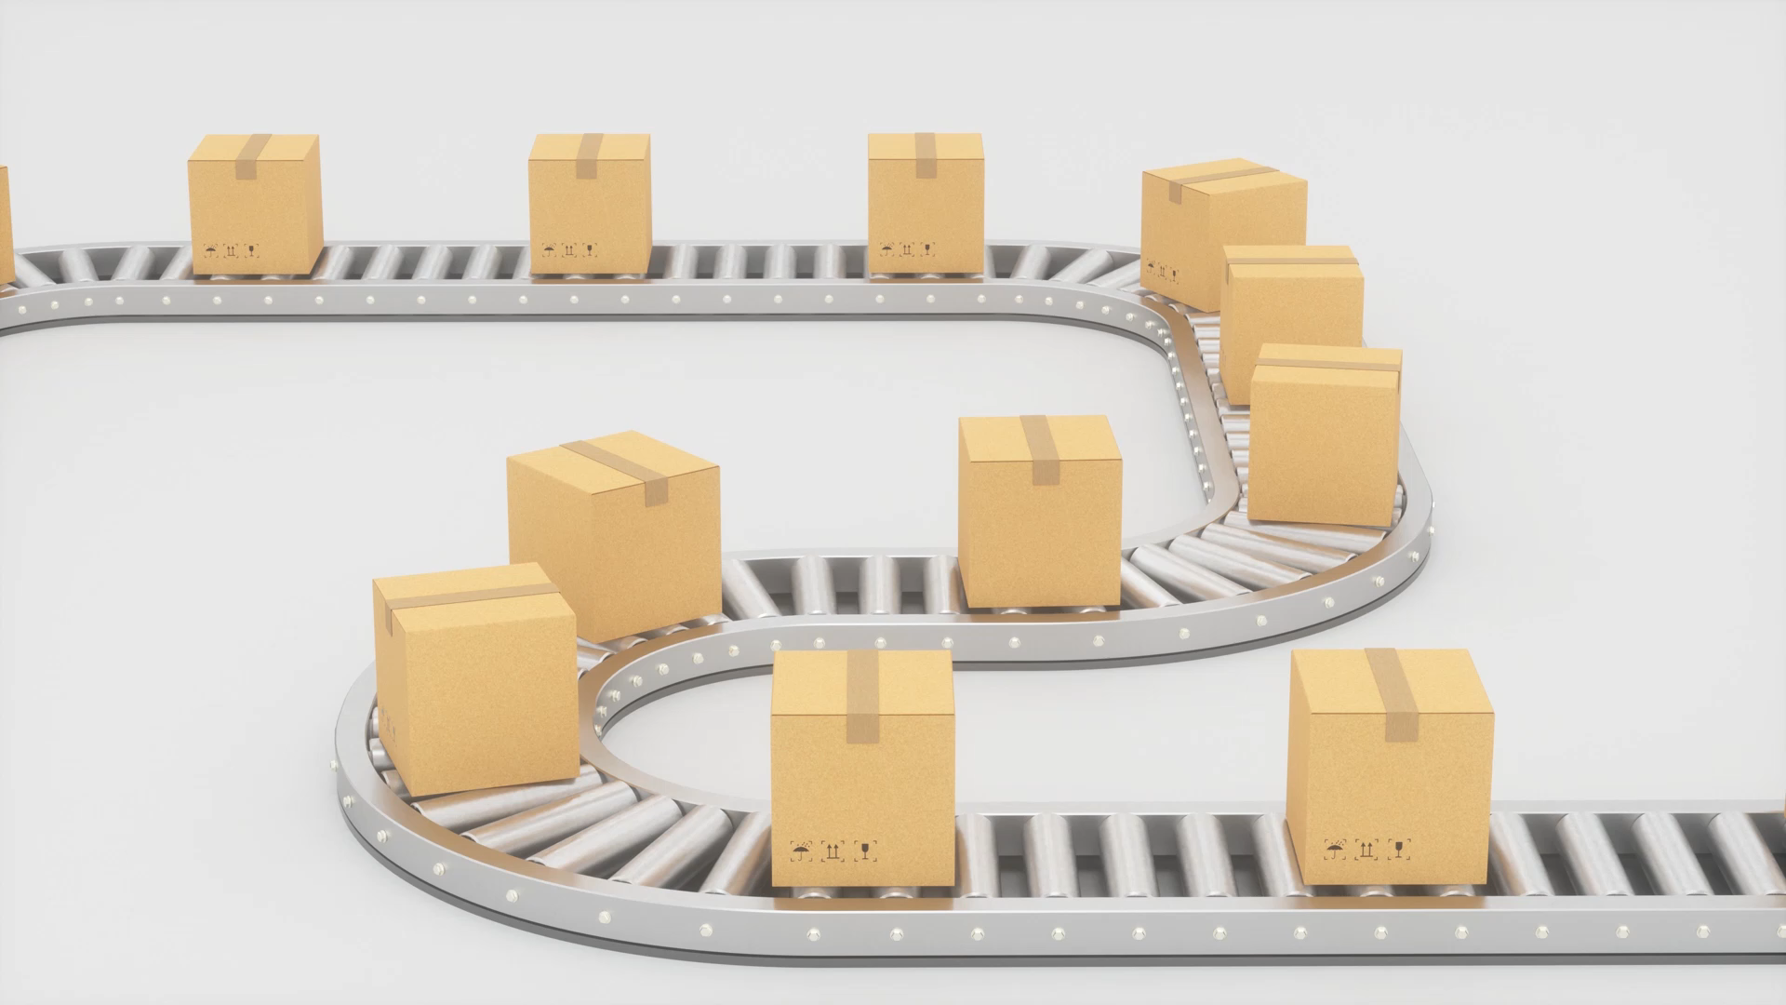
Transport layer
By
Dr Yasir Afaq

Slide 2
Transport layer
Transport Layer is the second layer in the TCP/IP model and the fourth layer in the OSI model.
It is an end-to-end layer used to deliver messages to a host.
It is termed an end-to-end layer because it provides a point-to-point connection rather than hop-to-hop, between the source host and destination host to deliver the services reliably.
The unit of data encapsulation in the Transport Layer is a segment.

Slide 3
Working of Transport Layer
The transport layer takes services from the Network layer and provides services to the Application layer
At the sender’s side: The transport layer receives data (message) from the Application layer and then performs Segmentation, divides the actual message into segments, adds source and destination’s port numbers into the header of the segment, and transfers the message to the Network layer.
At the receiver’s side: The transport layer receives data from the Network layer, reassembles the segmented data, reads its header, identifies the port number, and forwards the message to the appropriate port in the Application layer.

Slide 4
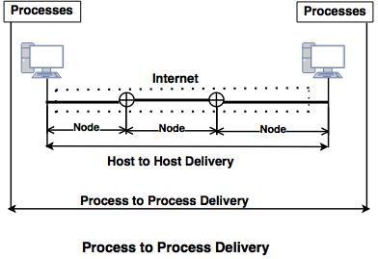
Responsibilities of a Transport Layer:
Process to process delivery:
Process-to-Process Delivery: A transport-layer protocol's first task is to perform process-to-process delivery.
A process is an entity of the application layer which uses the services of the transport layer.
Two processes can be communicated between the client/server relationships

Slide 5
Client Server Paradigm
Node to Node : Data Link
Host to Host: Network Layer
Process to Process: Transport Layer

Slide 6
Process to Process
There are many ways to obtain the process-to-process communication, and the most common way is through the client/server paradigm.
A process is called a client on the local-host. Usually, the remote host is needed services on the processes, that is called server.
The same name applies to both processes (client and server). IP address and port number combination are called socket address, and that address defines a process and a host.

Slide 7
Multiplexing and Demultiplexing
Multiplexing: At the sender site, multiple processes can occur, and those processes are required to send packets. It is a technique that combines multiple processes into one process.
Demultiplexing: At the receiver site, it is a technique that separates many processes.

Slide 8
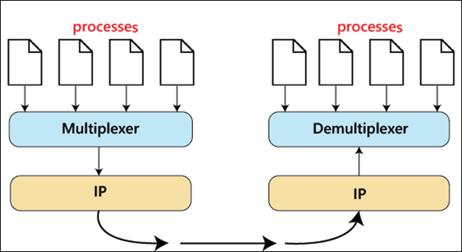

Slide 9
Socket and Port
Computer generated processes require unique address to send and receive information. Port numbers are used for that purpose.
Process socket is a combination of host IP and process port number. Easy example is the Telnet service that is using port 23 by default.
Knowing host IP address (for example 12.34.45.56) the socket address can be created (12.34.45.56:23). Even though Telnet’s default port is 23, it can differ if the network administrator decides to reconfigure default value.
Port number is written after the IP address and is separated by the colon. System would recognise it as a port pointer, and would not consider it as additional octet of the IP. The main purpose of the ports, is creation of the virtual connection between two same processes on different machines.

Slide 10
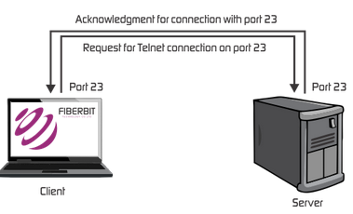
Port and Socket
TCP/IP communication simplifies with the help of ports use. Port numbers can represent different applications, but system ensures there would be no error or mistake.
Defined processes like Telnet are recognised by the machines automatically. If Computer is requesting IP with port 23, the reply would already contain all the information necessary for beginning of the Telnet session. The example of such connection establishment is shown in Figure

Slide 11
Range of Port address
Port number | Process name | Protocol used | Description
20 | FTP-DATA | TCP | File transfer-data
21 | FTP | TCP | File transfer-control
22 | SSH | TCP | Secure Shell
23 | TELNET | TCP | Telnet
25 | SMTP | TCP | Simple Mail Transfer Protocol
53 | DNS | TCP and UDP | Domain Name System
67 and 68 | DHCPv4 | UDP | Dynamic Host Configuration Protocol
69 | TFTP | UDP | Trivial File Transfer Protocol
80 | HTTP | TCP and UDP | Hypertext Transfer Protocol
110 | POP3 | TCP | Post Office Protocol 3
123 | NTP | TCP | Network Time Protocol
143 | IMAP | TCP | Internet Message Access Protocol
443 | HTTPS | TCP | Secure HTTP
546 and 547 | DHCPv6 | UDP | Dynamic Host Configuration Protocol
3389 | RDP | TCP | Remote Desktop Protocol
There are three ranges of ports. Each range is created for some specific purpose. First range is between 0 and 1023. Those ports are used by operating system, default applications and services, and network administrators.
These ports are called Well Known Ports, and users have no access to them. TCP/IP protocols use them for TCP, UDP, Telnet, and FTP. Most used protocols are shown in Table 1.

Slide 12
Range
Next range of ports is between 1024 and 49151. These ports are called Registered Ports.
They can be used by network users and/or applications with no administrative privileges. Some of the ports in this range can become default ports for some process or application.
In this scenario, port should be registered with IANA (Internet Assigned Numbers Authority).
Last range of ports is called Dynamic/Private ports. The range bounds are 49152 and 65535. Range ports can be used with no restrictions.

Slide 13
UDP (User Datagram Protocol)
UDP was developed by David P Reed in 1980. It is a connection-less and unreliable protocol.
This means when the data transfer occurs; this protocol does not establish the connection between the sender and receiver.
The receiver does not send any acknowledgment of the receiving data.
It sends the data directly. In the UDP, the data packet is called datagram. UDP does not guarantee your data that will reach its destination or not.
It does not require that the data reach the receiver in the same order in which the sender has sent the data.

Slide 14
Transmission Control Protocol
TCP stands for Transmission Control Protocol. It was introduced in 1974. It is a connection-oriented and reliable protocol.
It establishes a connection between the source and destination device before starting the communication.
It detects whether the destination device has received the data sent from the source device or not. If the data received is not in the proper format, it sends the data again.
TCP is highly reliable because it uses a handshake and traffic control mechanism.
In TCP protocol, data is received in the same sequencer in which the sender sends the data. We use the TCP protocol services in our daily life, such as HTTP, HTTPS, Telnet, FTP, SMTP, etc.

Slide 15
Difference between UDP and TCP
UDP | TCP
UDP stands for User Datagram Protocol. | TCP stands for Transmission Control Protocol.
UDP sends the data directly to the destination device. | TCP establishes a connection between the devices before transmitting the data.
It is a connection-less protocol. | It is a connection-oriented protocol.
UDP is faster than the TCP protocol. | TCP is slower than the UDP protocol.
It is an unreliable protocol. | It is a reliable protocol.
It has not a sequence number of each byte. | It has a sequence number of each byte.

Slide 16
Protocols
Protocols of Transport Layer:
TCP(Transmission Control Protocol)
UDP (User Datagram Protocol)
SCTP (Stream Control Transmission Protocol)
DCCP (Datagram Congestion Control Protocol)
ATP (AppleTalk Transaction Protocol)
FCP (Fibre Channel Protocol)
RDP (Reliable Data Protocol)
RUDP (Reliable User Data Protocol)
SST (Structured Steam Transport)
SPX (Sequenced Packet Exchange)

